Slide 1

The Greater London Borough Analysis
Enyinna Echetanna Egejuru
December 2020

Slide 2
Introduction
Greater London is categorised as a cosmopolitan city being the home to roughly 8.9 million people
London is also one of the top financial capitals in Europe.
Made up of 33 boroughs each having its own distinct characteristics.
Choosing a location within Greater London boroughs to setup shop or to reside can be extremely difficult objective to achieve, however with the help of population data, crime data and location data from Foursquare, we will aid you in making a well-informed decision.

Slide 3
Business Problem
In Greater London, which borough would be a better place to start up a business or live in?
By using data science methodology and machine learning techniques like K-Means Clustering the objective of this capstone project is to analyse gathered data and select the best borough in the Greater London which aims to provide an answer to the above question highlighted.

Slide 4
Target Audience
Entrepreneurs set out to either start a business or expand their existing business in the Greater London
Persons planning to move to Greater London and looking for the perfect location that will meet their expectations
Upcoming data scientists that would like to have an insight to some of the most used techniques to obtain data, analyse it and finally, tell a story out of it.

Slide 5
Data Description
Population / Location Data
We get population data for Greater London, this data shows the 2019 estimates from the National Office of Statistics It contains population information for the United Kingdom broken down by age, this data is filtered to show the London 33 boroughs.
For geolocation data we use the Geopy package in python to derive the co-ordinate data for the listed 33 boroughs.
Venues Data – leveraging on the Foursquare API
Foursquare API provides point of interest information and geolocation based on coordinates provided, we will use this API to get relevant venue location information for Greater London.
Crime Data
Criminal activity for each borough will be analysed using Recorded Crime: Geographic Breakdown for Greater London - MPS Borough Level Crime (most recent 24 months) from London Data Store. It contains information about the number of crimes at borough levels of London per month, according to crime type from the Metropolitan Police Service.

Slide 6
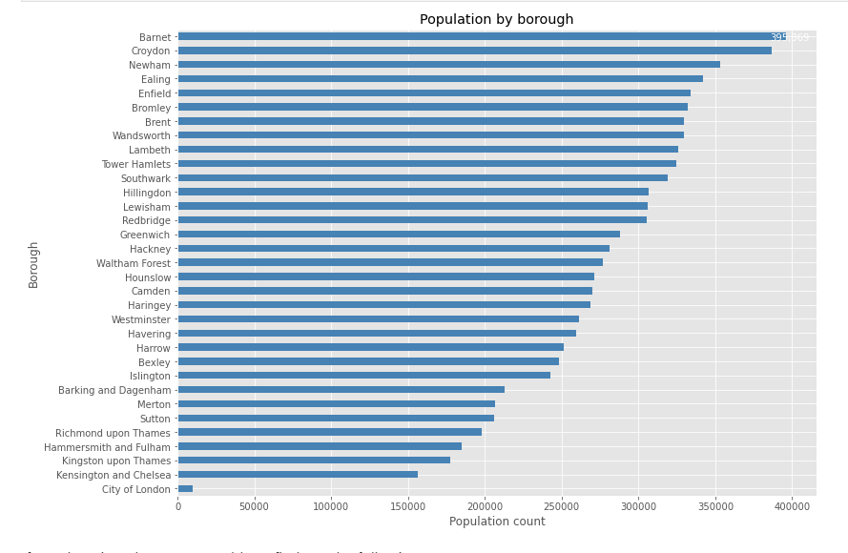
Methodology
Location and Population Data
Examining the population data, we see that the borough with the highest population is Barnet while the least populated borough is the City of London

Slide 7
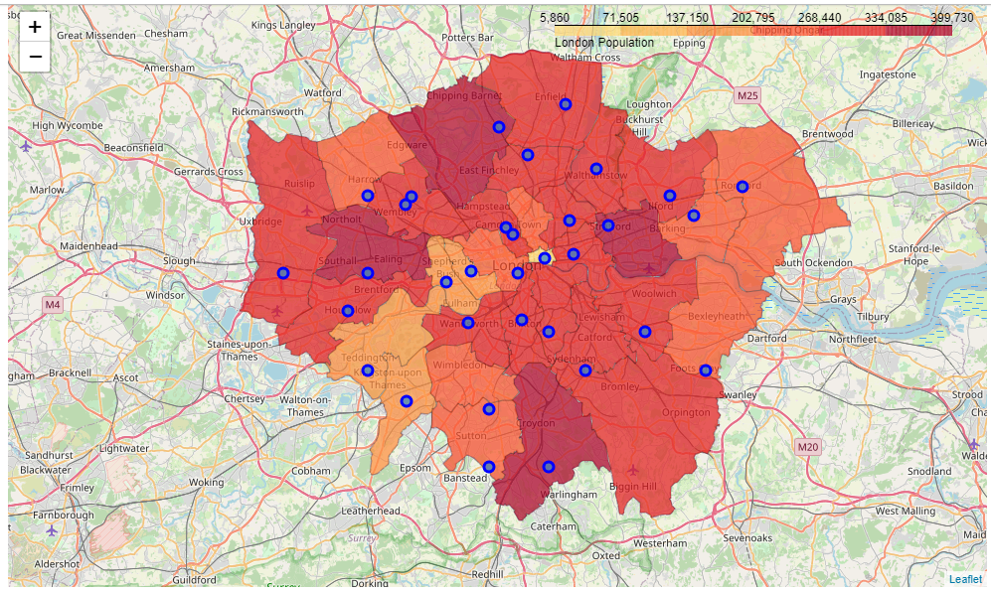
Methodology
Location and Population Data
Using Geopy library we were also able to get the co-ordinates for the boroughs and plot them on a map using the Folium Geospatial visualization library.

Slide 8
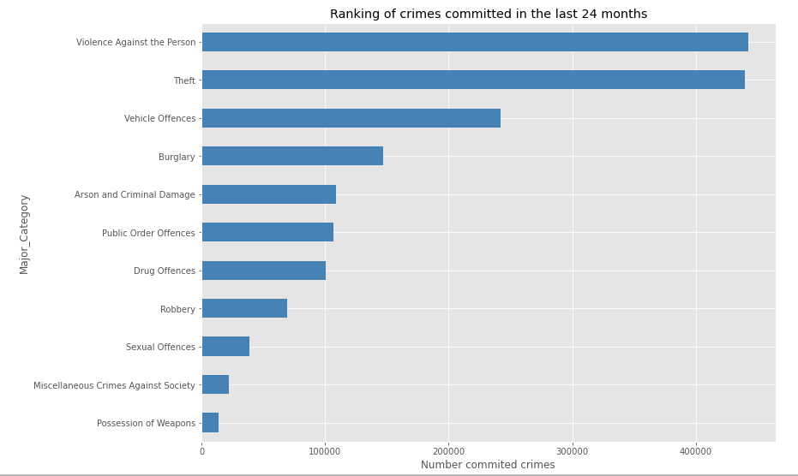
Methodology
Crime Data
Examining the crime data, we can see the most committed crime is Violence against the person followed by theft and vehicle offences and the least committed crime is possession of weapons

Slide 9
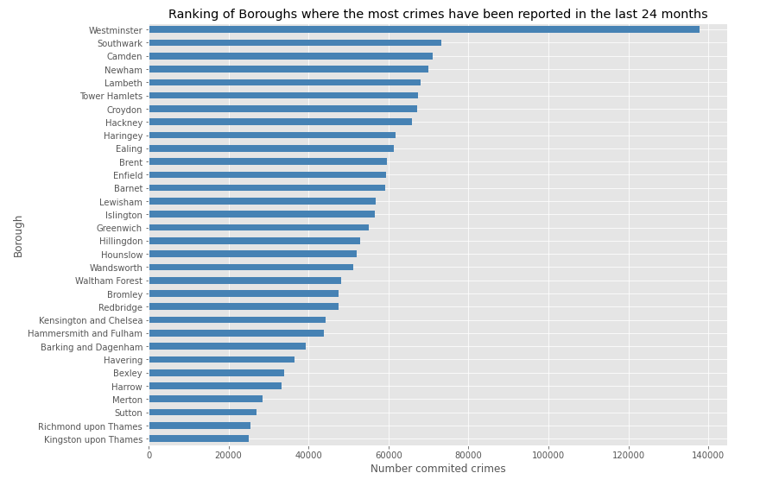
Methodology
Crime Data
Looking at where these crimes where committed we can see that Westminster and Southwark are the boroughs ranking the highest committed crimes while Kingston upon Thames has the least reported cases.

Slide 10
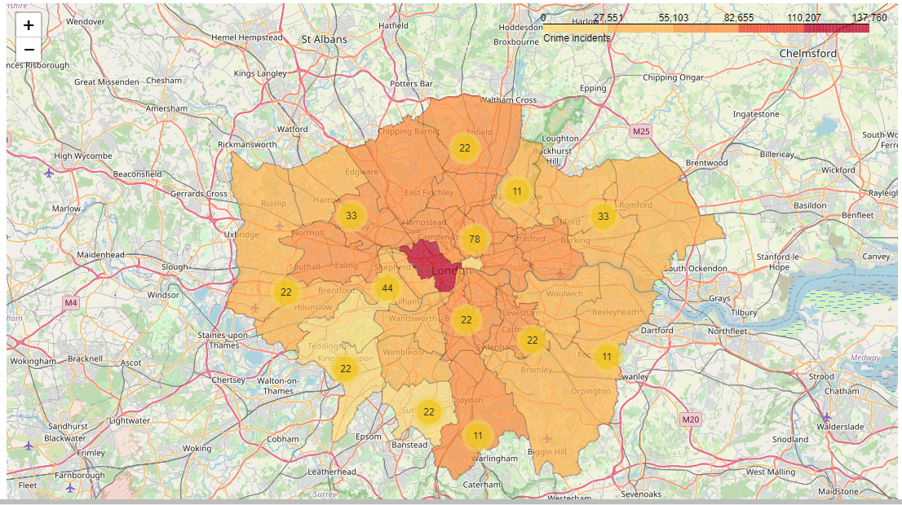
Methodology
Crime Data
Plotting the above information on a map we have the following choropleth visualization below which shows the crimes committed by borough overlayed with the category of crime committed.

Slide 11
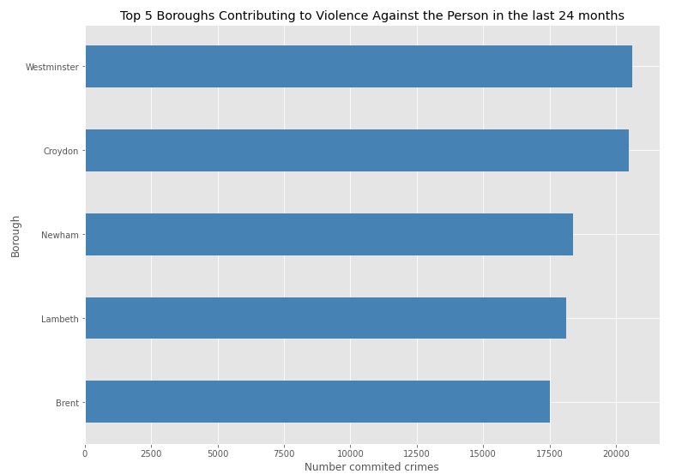
Methodology
Crime Data
Delving deeper we breakdown the highest reported category of crime – Violence Against the Person and we see that Westminster is the borough where such case is being reported the most followed by Croydon then Newham.

Slide 12
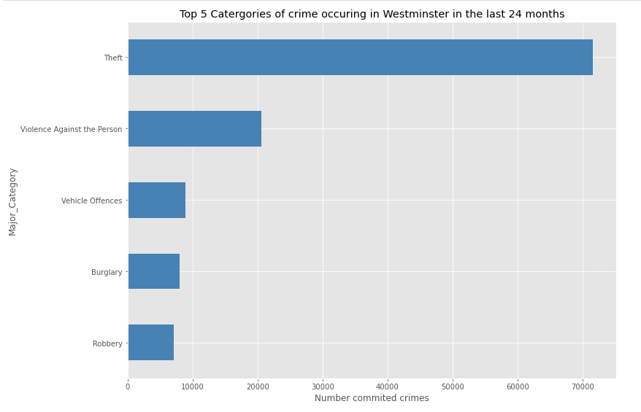
Methodology
Crime Data
On the other hand, when looking at the borough of Westminster we see that the most reported crime is Theft, followed by Violence Against the Person with the least case as robbery.

Slide 13
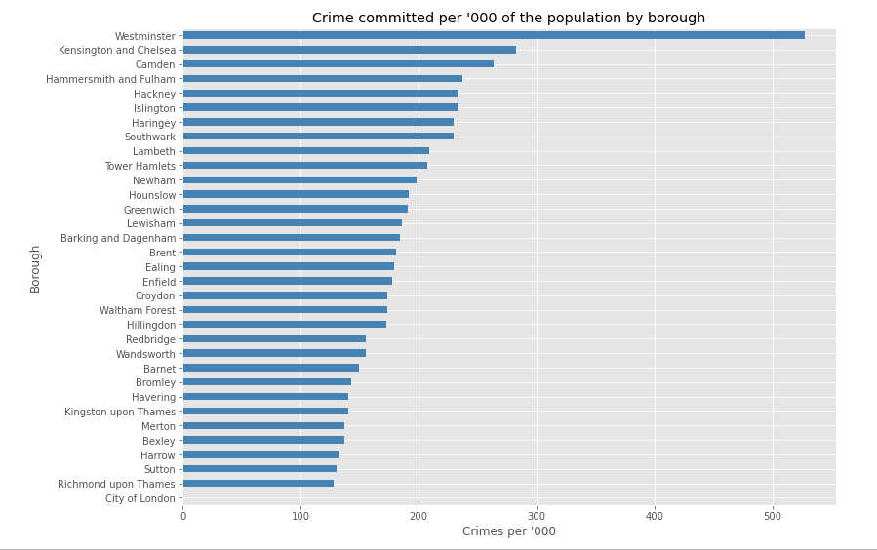
Methodology
Crime Data
Nominalising the crimes committed by the population of each individual borough we see that Westminster also ranks the highest followed by Kensington and Chelsea and the least is Richmond upon Thames.

Slide 14
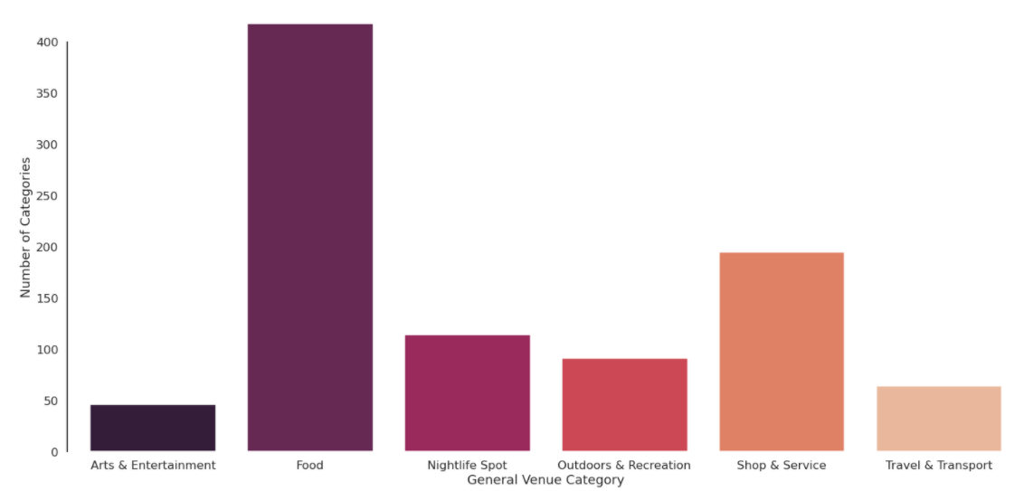
Methodology
Venue Data
In deriving the Venue data, we take the borough information from the location data and gather the data of venues using Foursquare, of which we had 928 venues, the venues were classified in to six broad categories – Nightlife spot, Food, Shop & Service, Outdoor & Recreation, Travel & Transport and Arts & Entertainment. Plotting the count of each category below

Slide 15
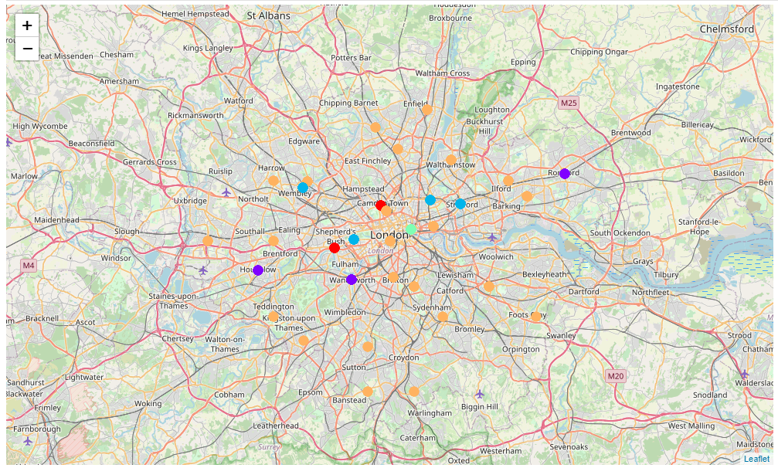
Methodology
Venue Data – K-means Clustering
Clustering these venues into five clusters using the K-means algorithm and visualizing them on the map we have the following figure below

Slide 16
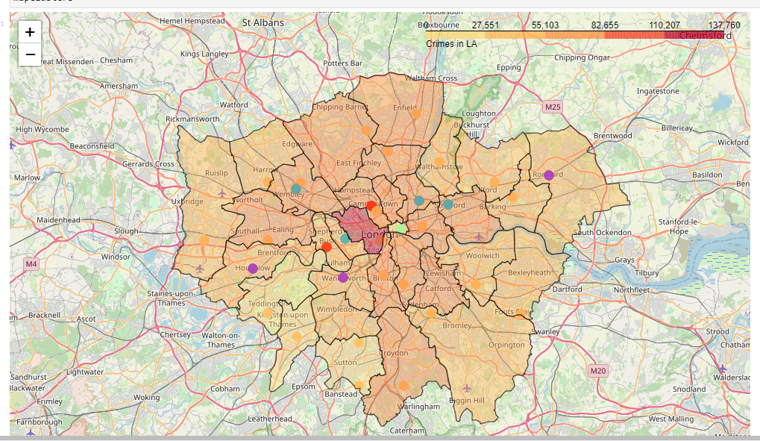
Methodology
Venue Data – K-means Clustering
Layering the clusters on the crime data we have the following map below

Slide 17
Results and Discussions
All the venues can be grouped into 5 clusters
Of all the clusters, Cluster 4 has least number of boroughs (1) and "Outdoor & Recreation" venue category is the most popular among boroughs in Cluster-5
"Food" venue category is the most popular among boroughs in clusters 1,2 & 3
Among all the venue categories, "Food" is the most popular category.
"Outdoor & Recreation" seems to be the second popular venue category followed by "Shop & Service"
Westminster and Southwark have the highest number of crimes recorded, however when compared to population Westminster and Kensington and Chelsea have the highest per capita ('000)

Slide 18
Conclusion
In this Capstone project, we analysed the boroughs in Greater London, this data which contained the population density per borough was sourced from the Office of National Statistics, using Geopy and the Folium library, we were able to retrieve co-ordinate data and visualise this data on a map.
Following this, we analysed the Metropolitan Police Service crime data for the past 24 months to determine which category and borough had the highest number of crimes and using a Choropleth map we visualised this data.
Finally using the Foursquare API, we were able to retrieve details of venues in neighbourhood and divided them into 5 clusters, also plotting them on a map layering with the crime data.

